Slide 1
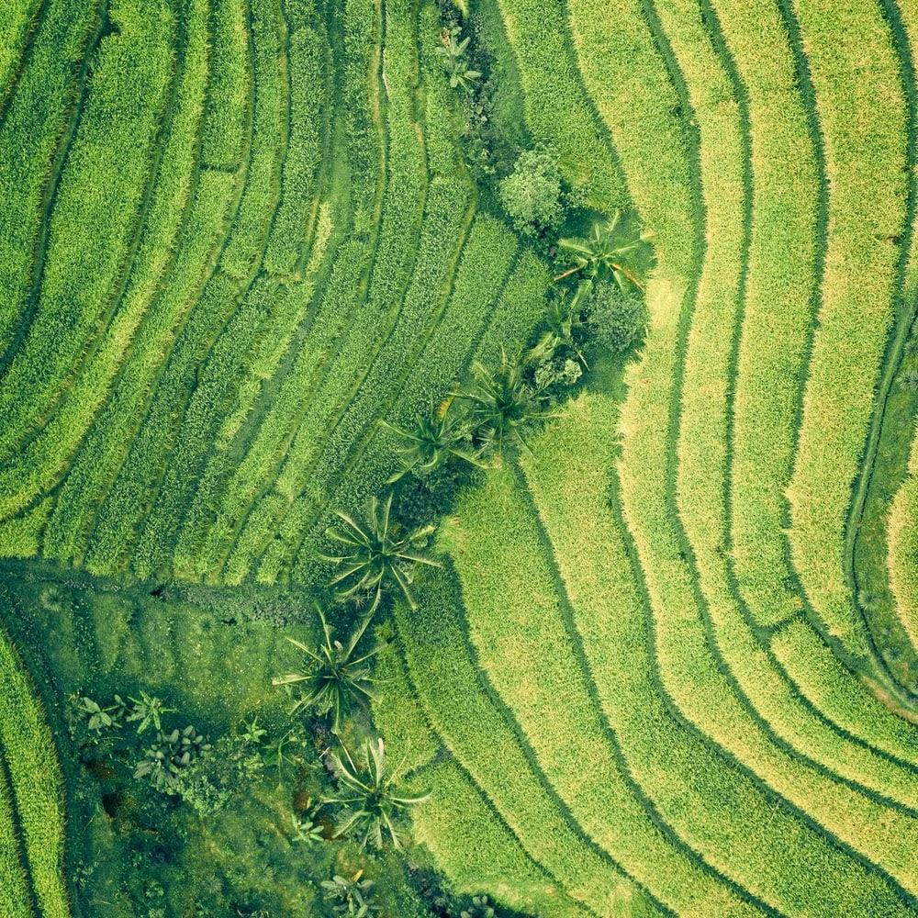
QUANTIFYING CARBON FOR CA$H
Team Carbon:
Kate Baker, Nika Gorski, Caroline Willett

Slide 2
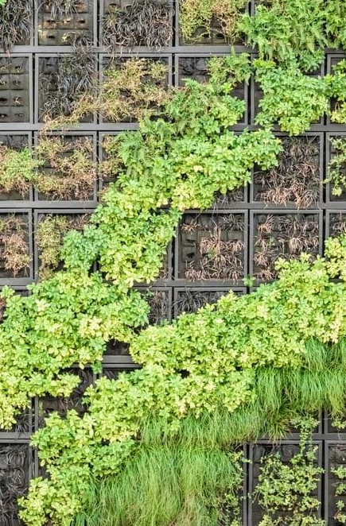
Dr. Deborah McGrath’s sustainable “carbon for cash” project uses multiple data sets and formulas to calculate the amount of carbon absorbed by the agroforestry systems. We will create carbon projections and a new process to accurately and easily pay farmers for carbon absorption now and in the future.

Slide 3
Current State
Dr. Deborah McGrath’s sustainable “carbon for cash” project uses multiple data sets and formulas to calculate the amount of carbon absorbed by the agroforestry systems.

Slide 4
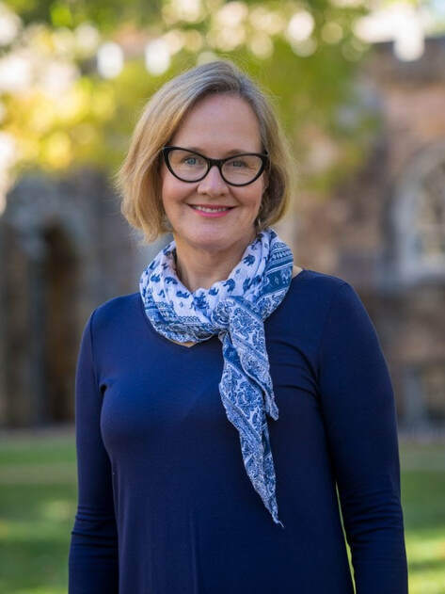
Dr. McGrath..
Sewanee Partners in Agriculture Program

Slide 5
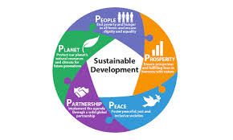
..Sustainable..
Notes:
Pilot project that we want to continue doing to create a great sustainable and economic outcome. Use sustainability to fix economy. Not just giving money but making them work for it.

Slide 6
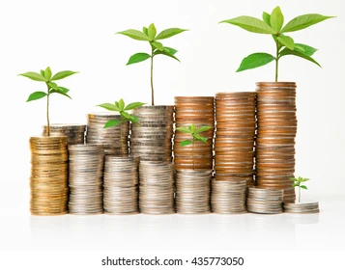
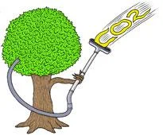
..Carbon for
Cash Project..

Slide 7
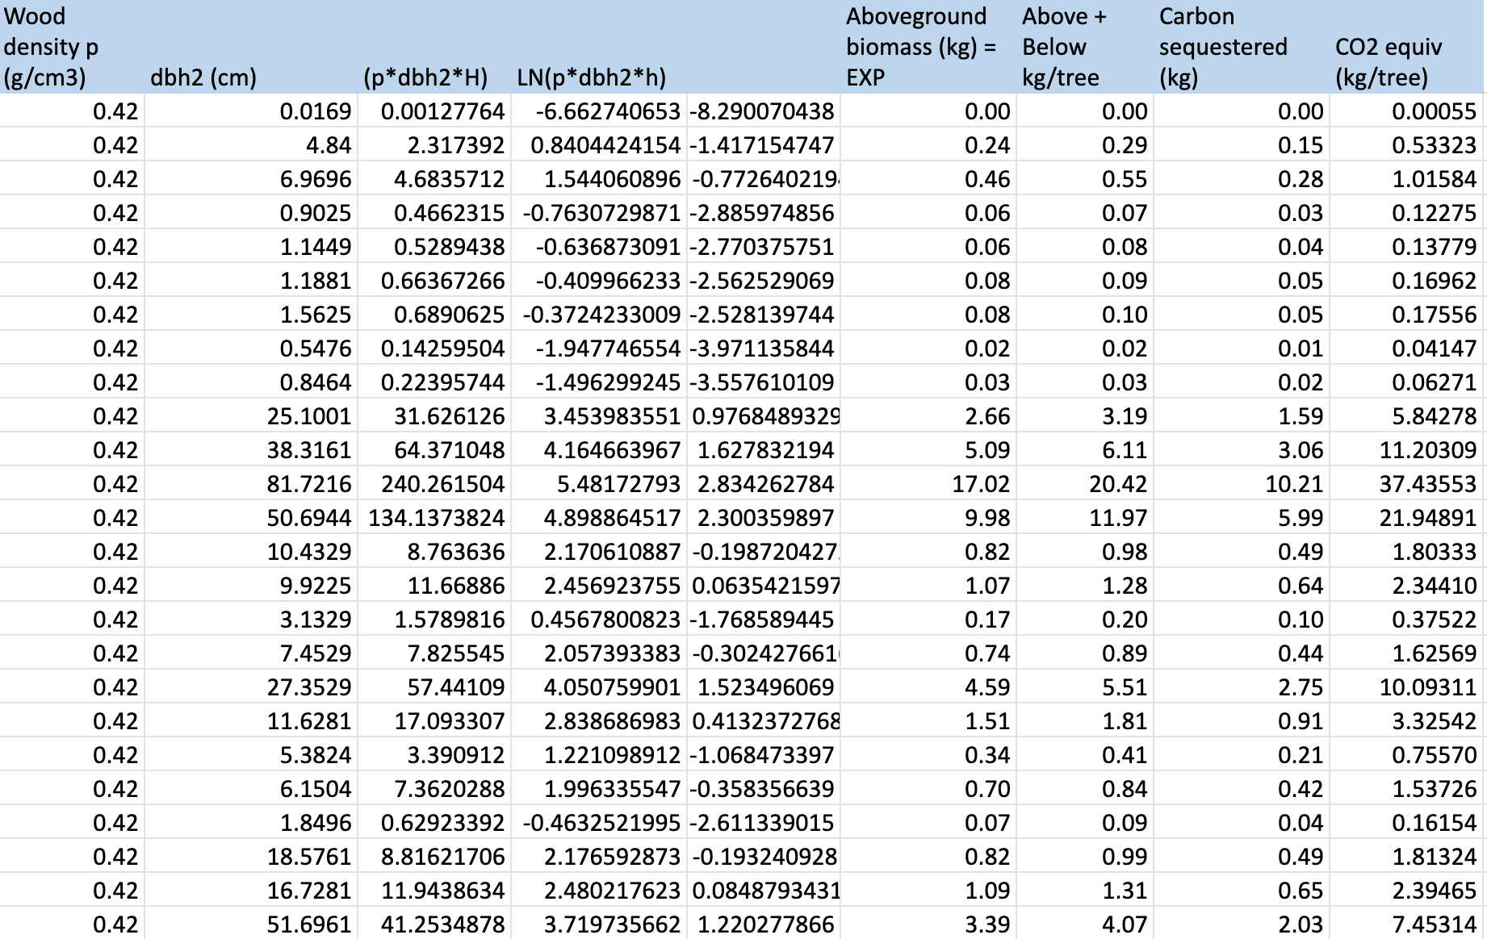
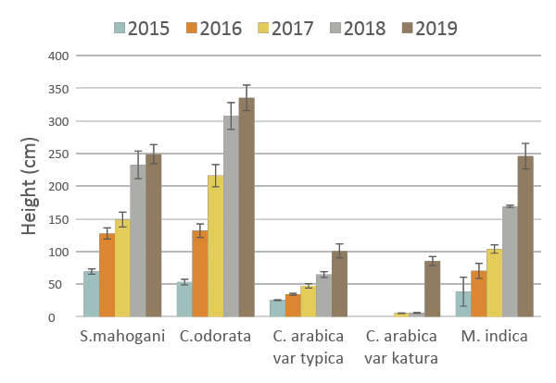
..Uses Multiple Data Sets and Formulas..

Slide 8
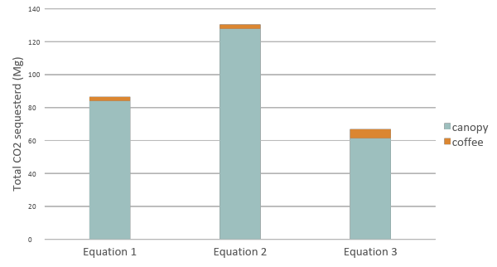
..To Calculate..
Equation | Source | Description
Y_{total} (kg) = 1.163 + 0.017 (D2H) | Cole and Ewel (2006) | 4 economic species, including Cedrela odorata, planted in polyculture in Costa Rica
Y_{aboveground} biomass (kg) = EXP(-2.187+0.916*LN(p*dbh2*H) | Chave et al. 2005 | General equation for tropical dry forest
Y_{aboveground} (lbs) = 0.25 (dbh2*H) | Trees for the Future.org | Derived from University of Nebraska extension publication and adapted for Sub-Saharan Africa
Y_{aboveground} biomass (kg) = 0.048D* 2.68 (for S. macrophylla only) | Adinugroho and Sidiyasa 2005 | Developed for Swietenia macrophylla King
..To Calculate..

Slide 9
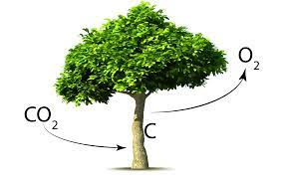
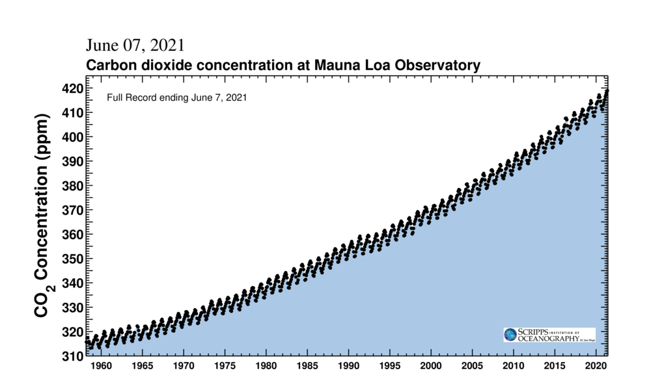
..The Amount of Carbon Absorbed..

Slide 10
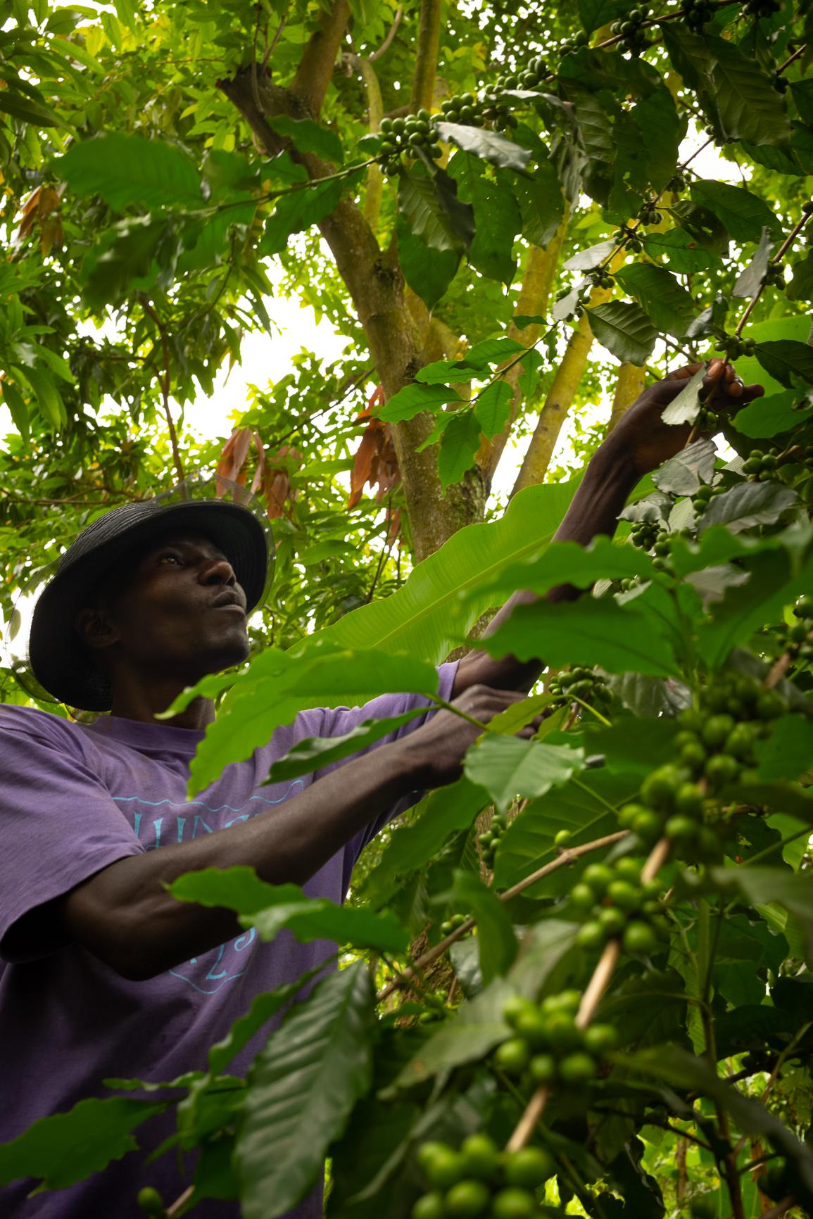
..by the Agroforestry Systems.
Agroforestry - agriculture incorporating the cultivation and conservation of trees.
Tree cover tripled over 5 years because of this project.

Slide 11
Future State
We will create carbon projections and a new process to accurately and easily pay farmers for carbon absorption now and in the future.

Slide 12
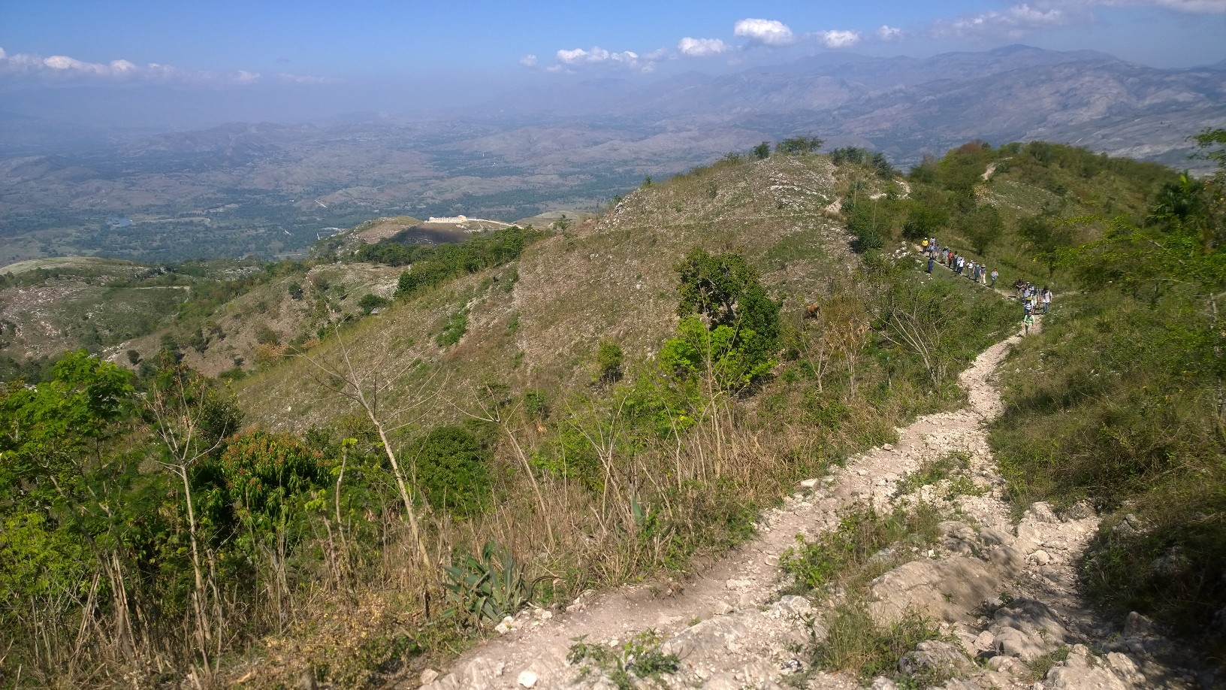
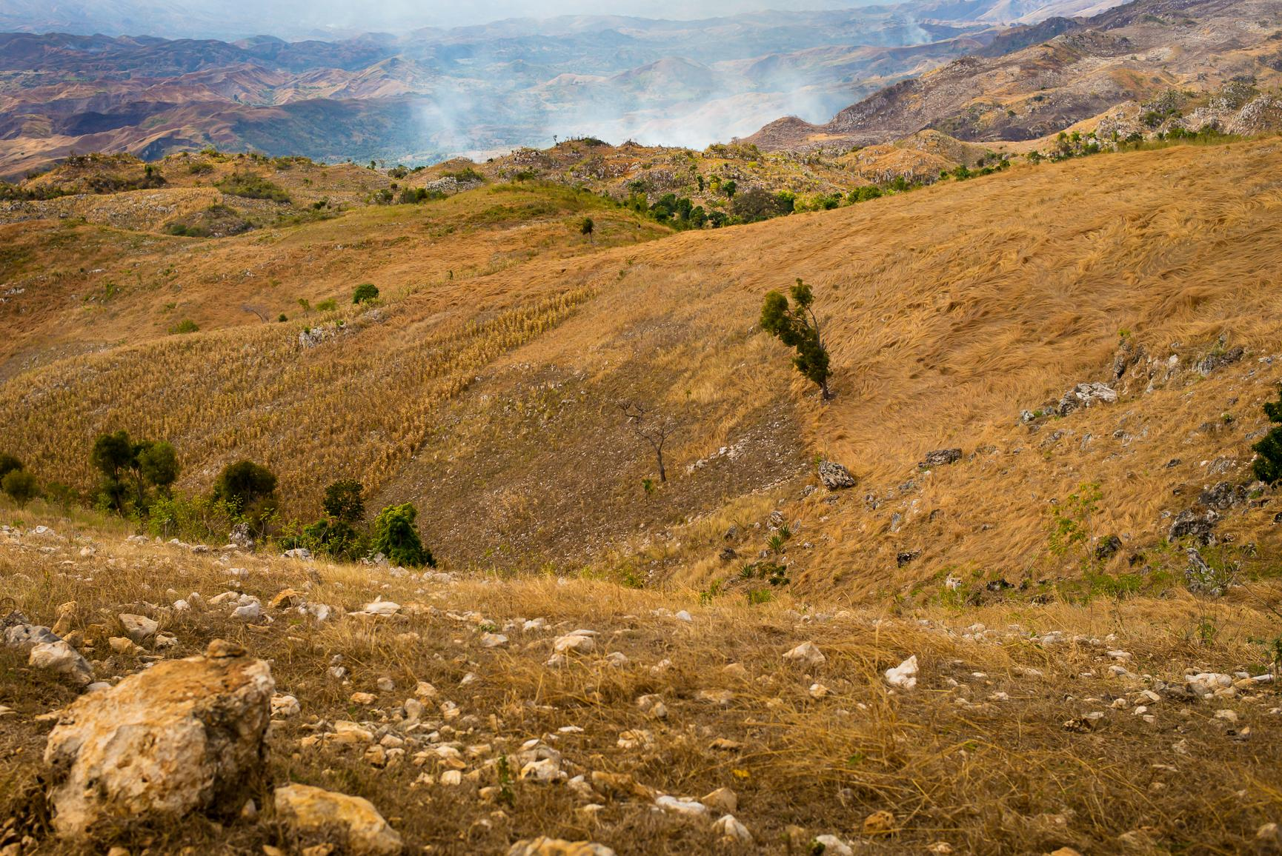
We Will Create Carbon Projections..
We need to come up with accurate equations that can project carbon sequestration over time.

Slide 13
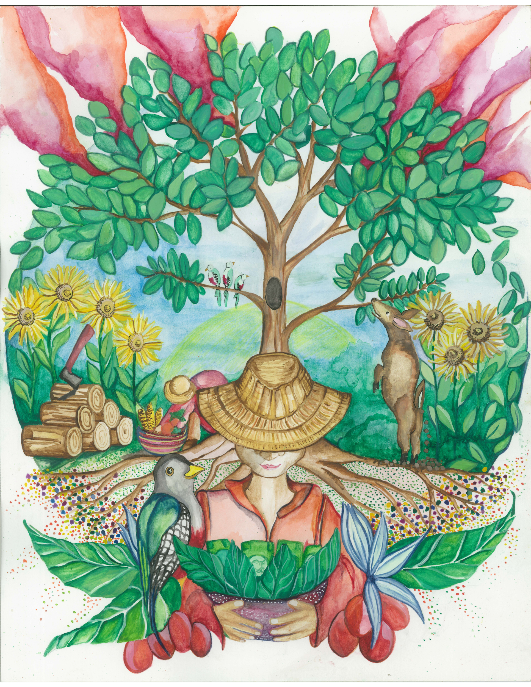
..And a New Process for Carbon Payments..
Estimate carbon sequestered (per farm) based on mean of diameter, wood density, and biomass
Literature review of allometric equations and carbon value (USD and HTG)
Compare results
Verify estimates based on current equations
End product?
DATABASE

Slide 14
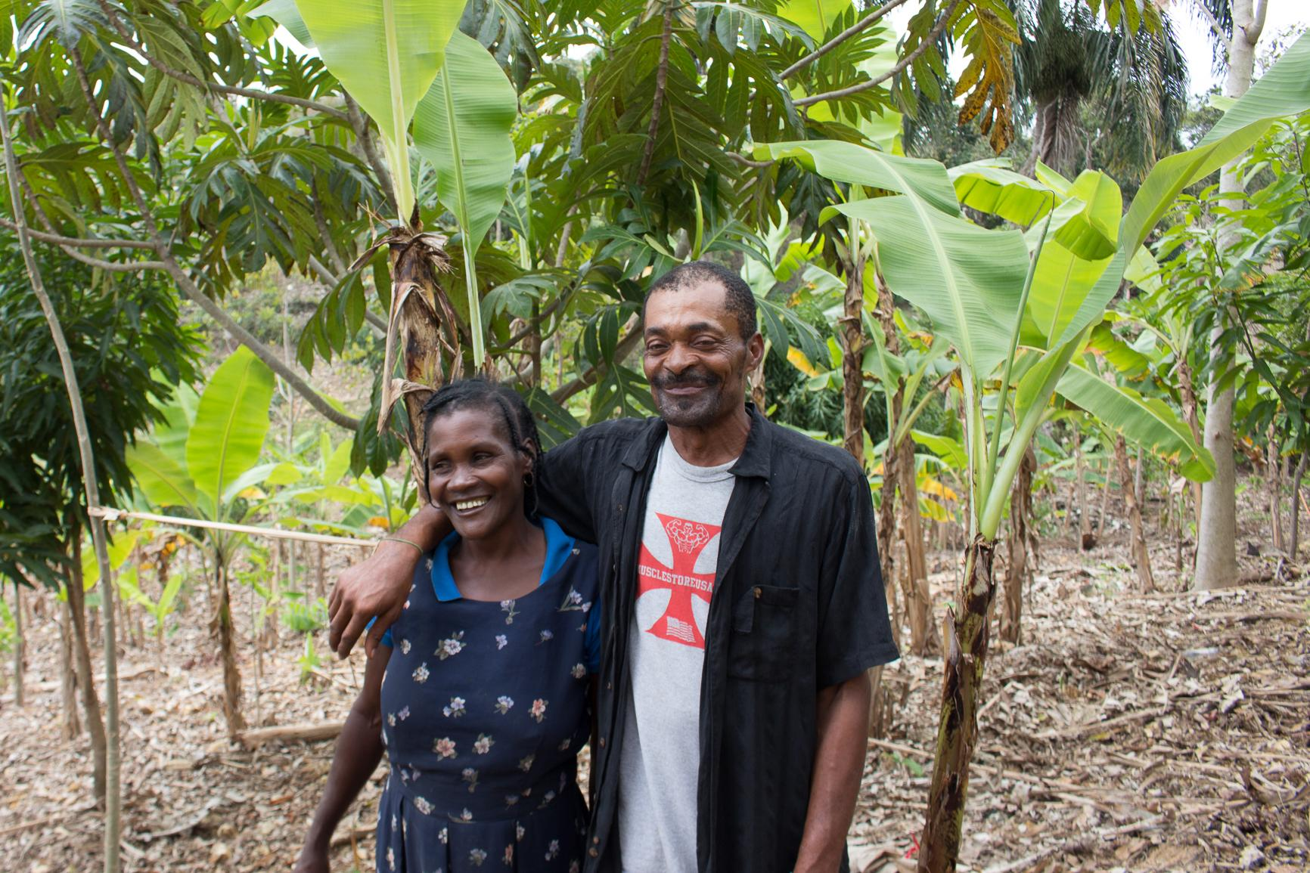
..To Accurately and Easily Pay Farmers..
Data is partially inaccurate and difficult to calculate
Ease and accuracy of payment will help the program to grow

Slide 15

..Now and In the Future.

Slide 16
Dr. Deborah McGrath’s sustainable “carbon for cash” project uses multiple data sets and formulas to calculate the amount of carbon absorbed by the agroforestry systems. We will create carbon projections and a new process to accurately pay farmers for carbon absorption now and in the future.
Questions?

